Slide 1

Maulana Azad National Institute of Technology
Bhopal, India, 462003
Department of Computer Science and Engineering
MINOR PROJECT REPORT
Semester 6
Neural Network Based Pattern identification of different human joints for different human walking styles by calculating the hip, knee, ankle angles of the person per 100 steps at a given angular speed.
Submitted by:
Nikita Chauhan 181112231
Duppati Sahithi 181112236
Niharika Shilpi 181112255
Rajeshwari Pandravisam 181112261
Under the guidance of
Dr. Vaibhav Soni Sir
1

Slide 2
Aim of the project
Neural Network Based Pattern identification of different human joints for different human walking styles by calculating the hip, knee, ankle angles of the person per 100 steps at a given angular speed when the person's information like age, height, mass, gait speed, leg length and gender is given.

Slide 3
Topics Covered
Introduction
Data Set Used
Models tested
Comparison among all models
Application
Future Scope
References

Slide 4
Introduction
What is Gait?
- Human gaits are the various ways in which a human can move, either naturally or as a result of specialized training.​
What is Gait Analysis?
- Gait analysis (GA) has been widely used to better understand the gait patterns of a wide range of populations. The application of this method has the ability to distinguish between normal and abnormal gaits.​

Slide 5
How legged & wheeled mechanisms differ?
- The posture of a wheeled mechanism is dependent upon the terrain, but a legged mechanism can isolate its body from the terrain— achieving a more stable stance​
​
What are bipedal robots? ​
- A bipedal walking robot is a type of humanoid robot which mimics like a human being and can be programmed to perform some tasks as required. This bipedal robot can assist humans to carry out the tasks or activities in hazardous environments.​

Slide 6
Data Set Used
Participants
Study participants included 42 volunteers, including 24 young adults (age 27.6 ± 4.4 years, height 171.1 ± 10.5 cm, and mass 68.4 ± 12.2 kg) and 18 older adults (age 62.7 ± 8.0 years, height 161.8 ± 9.5 cm, and mass 66.9 ± 10.1 kg). All participants were free of any lower-extremity injury in the last six months before the data were collected, and all were free of any orthopedic or neurologic disease that could interfere with their gait patterns.​
Data acquisition
Standard gait-analysis procedures were employed to collect data using a motion-capture system that had 12 cameras. The data were collected using a three-dimensional (3D) motion-capture system, force platforms and an instrumented treadmill while the subjects walked barefoot over a range of gait speeds.​

Slide 7
The original data set used contains the walking styles of 42 persons of different age groups walking with 8 different angular speeds. ​
We have observed how pelvis, hip, knee, ankle and foot angles change with respect to x, y, z axes and recorded the observations for 100 steps. ​
Input data contains personal information like age, height, mass, gait speed, leg length, gender,.. And we expect the model to predict the walking style. ​

Slide 8
Combined Labeled Data Set Description:
The data set is collected for 25 subjects using wearable accelerometer (6-Degree IMU sensors) for 7 different activities named: Jogging, Normal walk, sit up, up stair walk, down stair walk, walk on heel and walk on toe for clinical examination purpose. We have considered the subject from different age group, gender and also collected data for pregnant woman data.
Each data file is having following column:
Time(s), ax(g), ay(g), az(g), wx(deg/s), wy(deg/s), wz(deg/s), AngleX(deg), AngleY(deg), AngleZ(deg), T(°) .​
Time(s) : time stamp ​
ax(g), ay(g), az (g): Acceleration about x, y and z axis ​
wx(deg/s) , wy (deg/s), wz (deg/s): Angular Velocity​
AngleX (deg) ,AngleY (deg) AngleZ (deg)
T(°): Joint angle value in degree.​
​

Slide 9
Models Used
Recurrent Neural Networks(RNN)
Recurrent means the output at current time step becomes the input to the next time step.​
At each element of sequence, the Recurrent Neural Network(RNN) considers not just the current input but what it remembers about the preceding elements.​
​
A RNN contains memory cells which allow the network to learn long-term dependencies in a sequence which means it can take the entire context into account when making a prediction. ​

Slide 10
Long Short Term Memory(LSTM)
Long short term memory (LSTM) is the most popular cell used in RNN which maintains a cell state as well as a carry state for ensuring that the signal is not lost as the sequence is processed .​
LSTM has 3 different gates and weight vectors:​
Forget gate ​
Input gate​
Output gate​
​

Slide 11
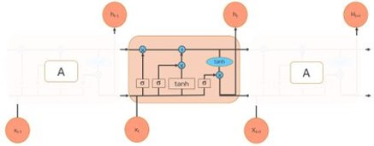
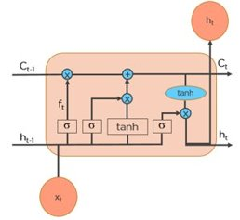
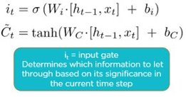
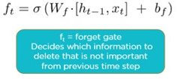
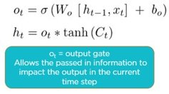

Slide 12
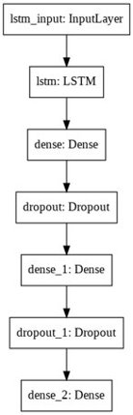
The LSTM Model we made ->​

Slide 13
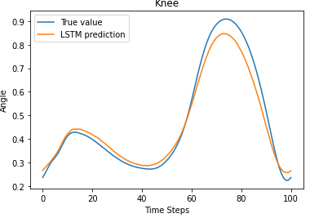
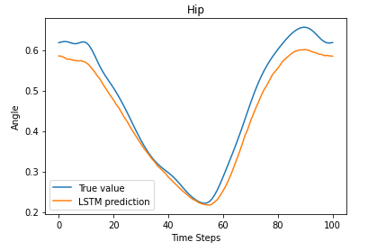
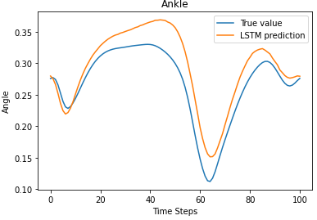
Plot of angular moments of the person for 100 steps through LSTM model and comparing that with the True Prediction​

Slide 14
Convolutional Neural Networks(CNN)
Convolutional Neural Network (CNN) or ConvNet, is a feed forward neural network that is generally used to analyze visual images by processing data with grid like topology.​
​
It is made up of 4 layers:-​
Convolution Layer​
ReLU Layer​
Pooling Layer​
Fully Connected Layer​

Slide 15
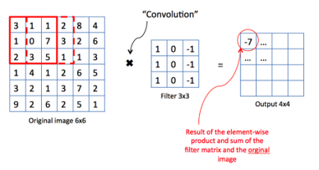
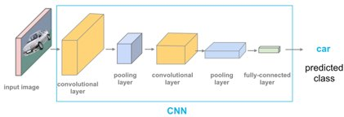
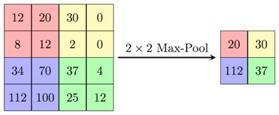
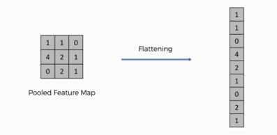

Slide 16
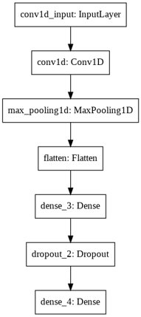
The CNN Model we made ->

Slide 17
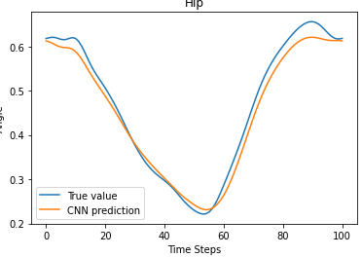
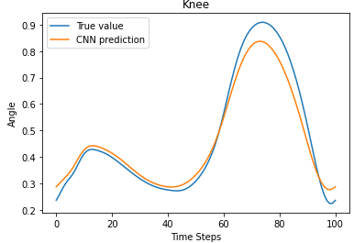
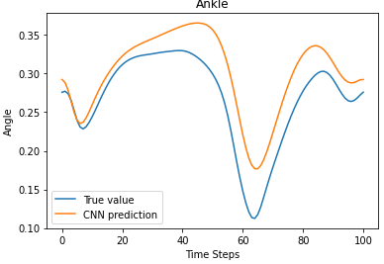
Plot of angular moments of the person for 100 steps through CNN model and comparing that with the True Prediction​

Slide 18
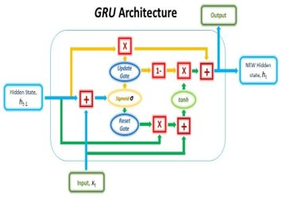
Gated Recurrent Unit(GRU)
Gated recurrent unit(GRU), it is another efficient RNN architecture.​
GRU has 2 different gates :​
Reset gate ​
Update gate​
These gates have their own set of weights that are adaptively updated in their learning phase.​
​

Slide 19
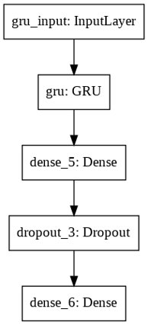
The GRU Model we made ->

Slide 20
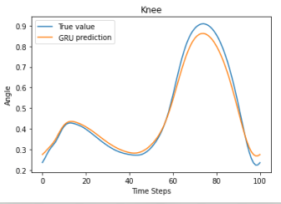
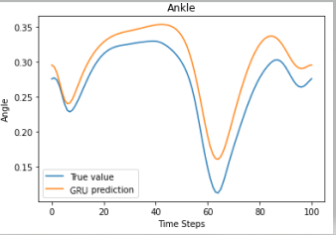
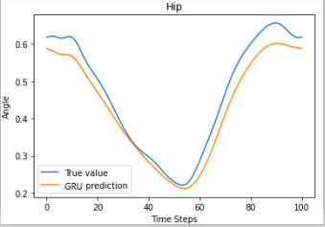
Plot of angular moments of the person for 100 steps through GRU model and comparing that with the True Prediction​

Slide 21
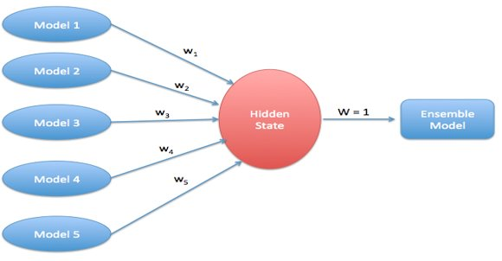
Ensembled model
Ensemble learning helps improve machine learning results by combining several models. ​
This approach allows the production of better predictive performance compared to a single model.​

Slide 22
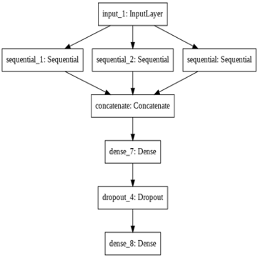
The Ensembled Model we made ->

Slide 23
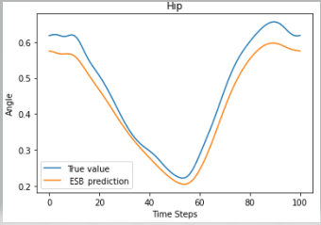
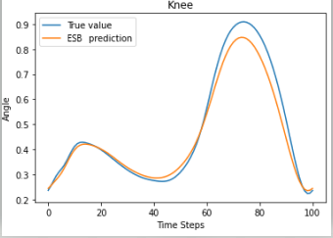
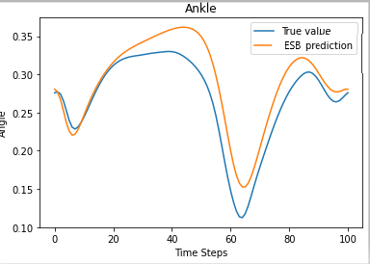
Plot of angular moments of the person for 100 steps through Ensembled model and comparing that with the True Prediction​

Slide 24
VGG model
The VGG convolutional neural network architecture, named for the Visual Geometry Group at Oxford, was an important milestone in the use of deep learning methods .​
​
In this we can add many VGG block to make the network more and more deep.​

Slide 25
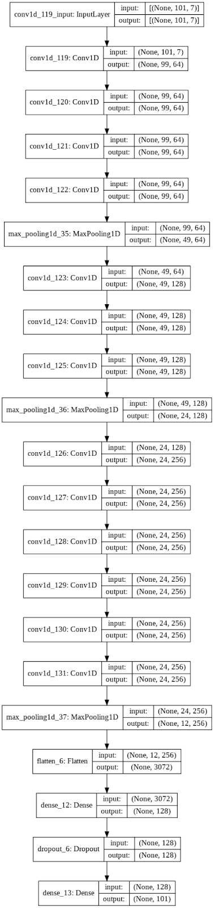
The VGG Model we made ->

Slide 26
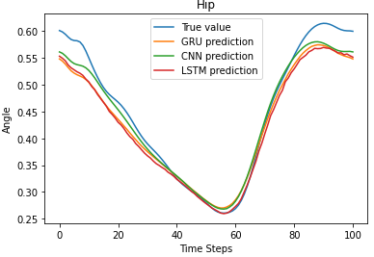
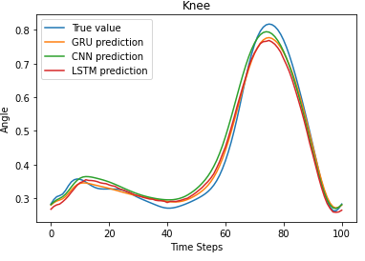
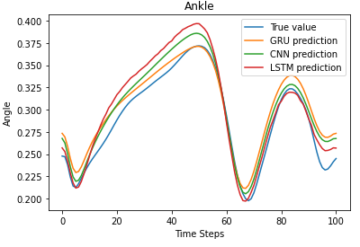
Comparison of our models
Plot of how the knee, hip and knee angles of the person changes for 100 steps by all the models and comparing that with our True Value.

Slide 27
S.no.​ | Model Name​ | Hip_mean_error​ | Knee_mean_error​ | Ankle_mean_error​
1​ | LSTM​ | 0.2806581851159908​ | 0.0351174787052302​ | 0.024801056202634574​
2​ | CNN​ | 0.029615926688723773​ | 0.04001808845529718​ | 0.026002174149845​
3​ | GRU​ | 0.02411768486540539​ | 0.03048257636745935​ | 0.024127558921955096​
4​ | Ensemble​ | 0.03201705333297378​ | 0.03801530859388143​ | 0.02617658254016726​
5​ | VGG​ | 0.03834686734542258​ | 0.03903141846883398​ | 0.028249844659730457​

Slide 28
Conclusion
We observe that the mean error of the GRU Model is comparatively less when compared with LSTM, GRU, CNN, Ensembled and VGG Model when calculated for knee, hip and ankle. Hence we conclude that GRU Model is performing well and is the best among rest.

Slide 29
Applications
Currently, humanoid robots are not capable of walking like human being. But with our research we can make robot walk like human just by changing the angle and position of ankle , hip and knee of the humanoid robots.

Slide 30
Future Scope
Currently the maximum accuracy of all models is 92%. We can use some other model and parameters to increase the accuracy of model and so of our project.
The dataset we used in our project is of human walk on treadmill and overground, for further improvement in bipedal robot we can take a dataset where we make our objects(human) walk on inclined plane like stairs, mountain, etc.

Slide 31
References
Semwal, V.B., Gaud, N., Lalwani, P. et al. Pattern identification of different human joints for different human walking styles using inertial measurement unit (IMU) sensors. Artif Intell Rev (2021). https://doi.org/10.1007/s10462-021-09979-x
Fukuchi CA, Fukuchi RK, Duarte M. 2018. A public dataset of overground and treadmill walking kinematics and kinetics in healthy individuals. PeerJ 6:e4640 https://doi.org/10.7717/peerj.4640
Fukuchi, Claudiane; Fukuchi, Reginaldo; Duarte, Marcos (2018): A public data set of overground and treadmill walking kinematics and kinetics of healthy individuals. figshare. Dataset. https://doi.org/10.6084/m9.figshare.5722711.v4
Alton F, Baldey L, Caplan S, Morrissey MC. 1998. A kinematic comparison of overground and treadmill walking. Clinical Biomechanics 13:434-440
Arnold JB, Mackintosh S, Jones S, Thewlis D. 2014. Differences in foot kinematics between young and older adults during walking. Gait Posture 39:689-694
Dua N, Singh SN, Semwal VB (2021) Multi-input CNN-GRU based human activity recognition using wearable sensors. Computing. https://doi.org/10.1007/s00607-021-00928-8

Slide 32
References
7. Ekinci M (2006) A new approach for human identification using gait recognition. In: International conference on computational science and its applications. Springer, Berlin
8. Gupta JP, Polytool D, Singh N, Semwal VB (2014) Analysis of gait pattern to recognize the human activities. IJIMAI 2(7):7–16
9. Gupta A et al (2020) Multiple task human gait analysis and identification: ensemble learning approach. In: Emotion and information processing. Springer, Berlin
10. Sivakumar S et al (2016) ANN for gait estimations: a review on current trends and future applications. In: 2016 IEEE EMBS conference on biomedical engineering and sciences (IECBES). IEEE.
11. Jason Brownlee, Stacking Ensemble for Deep Learning Neural Networks in Python https://machinelearningmastery.com/stacking-ensemble-for-deep-learning-neural-networks/
12. Jason Brownlee, How to Develop VGG, Inception and ResNet Modules from Scratch in Keras https://machinelearningmastery.com/how-to-implement-major-architecture-innovations-for-convolutional-neural-networks/
13. Aishwarya Singh, June 18, 2018. How to Develop VGG, Inception and ResNet Modules from Scratch in Keras https://www.analyticsvidhya.com/blog/2018/06/comprehensive-guide-for-ensemble-models/

Slide 33
Copyrights
Copyright 2018 Fukuchi et al.

Slide 34

Thank you

